Slide 1



Web and Internet
Class VI
lab 12

Slide 2
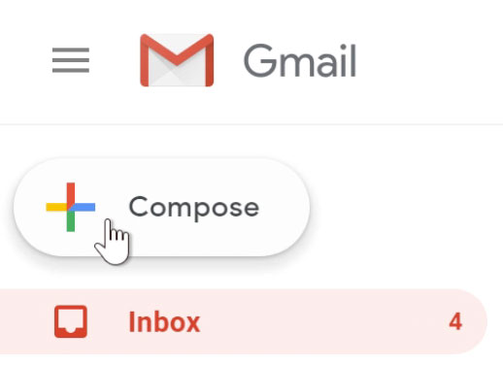
Sending a Mail
go to Gmail and click on Compose

Slide 3
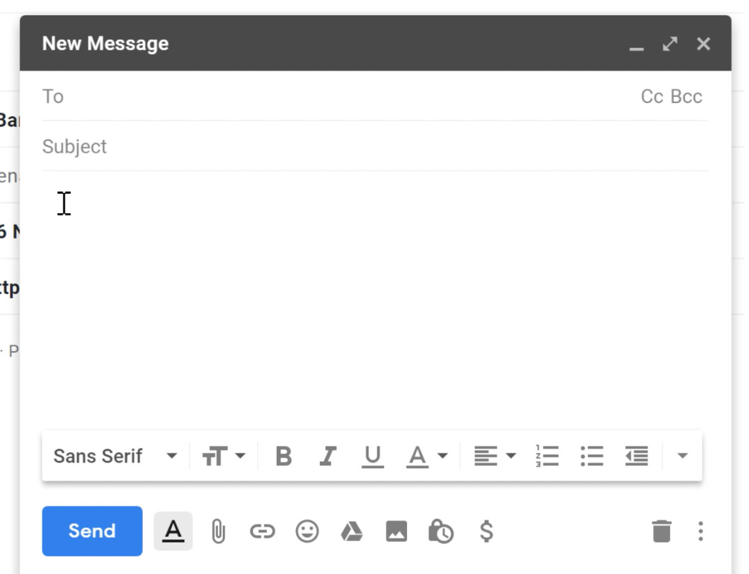
Sending a Mail
The compose window will appear in the lower-right corner of the page.

Slide 4
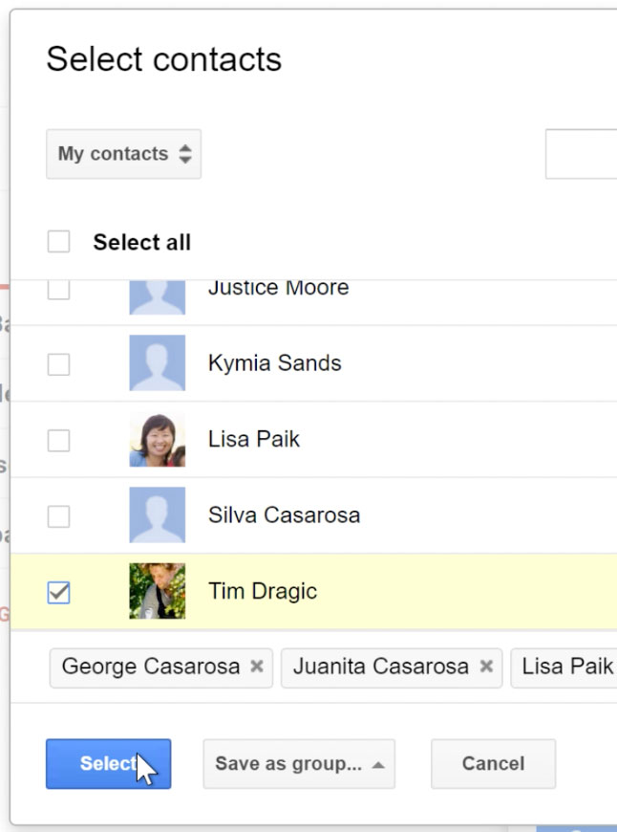
Sending a Mail
select receipent you want to send mail

Slide 5
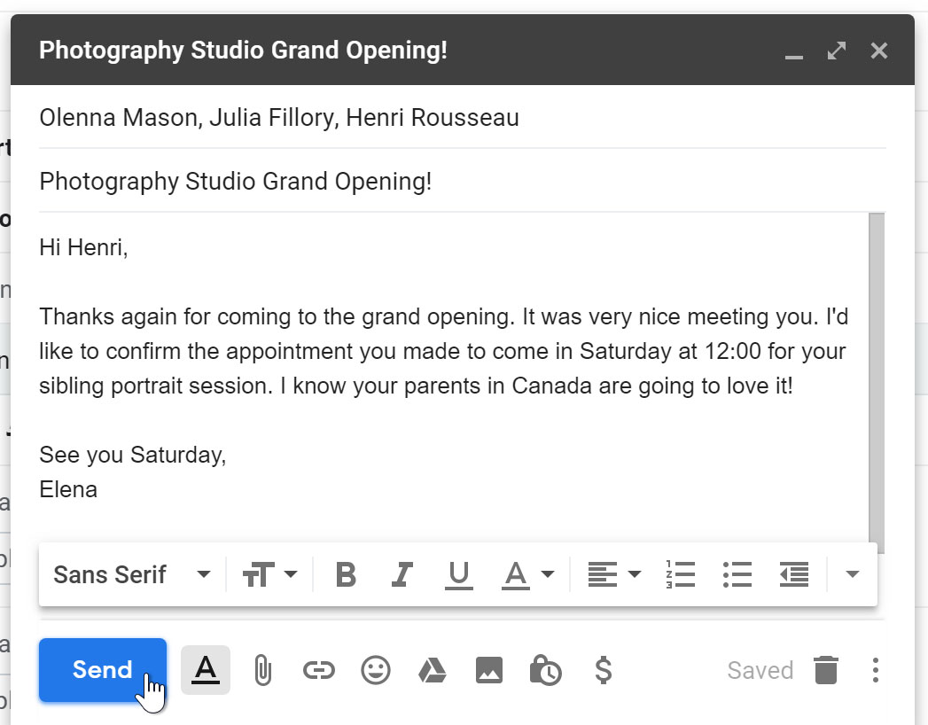
Sending a Mail
type text and
subject and click on send

Slide 6
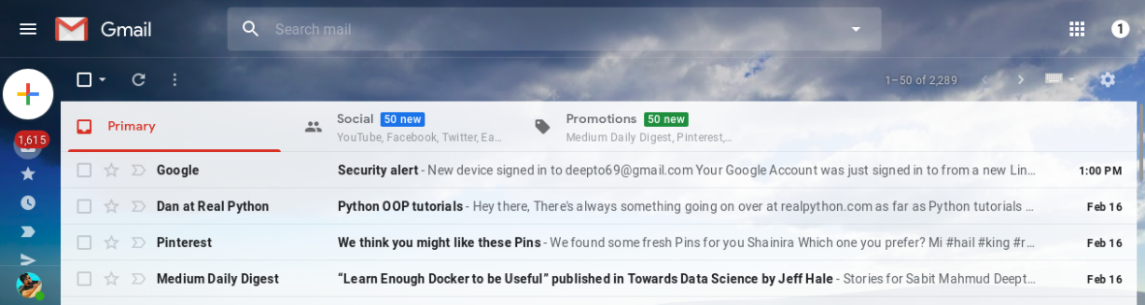
Check Inbox
Go to Gmail and you will see the default inbox page view. Click
any of them to read

Slide 7


